Slide 1
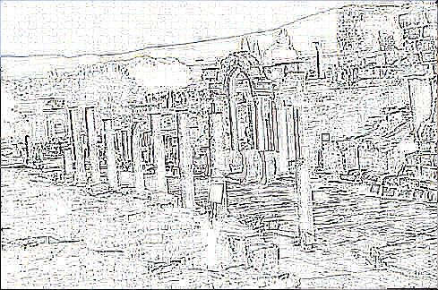
Ephesus
Revelation 2:1-7
Wallace, Steven J.
www.RevelationAndCreation.com

Slide 2
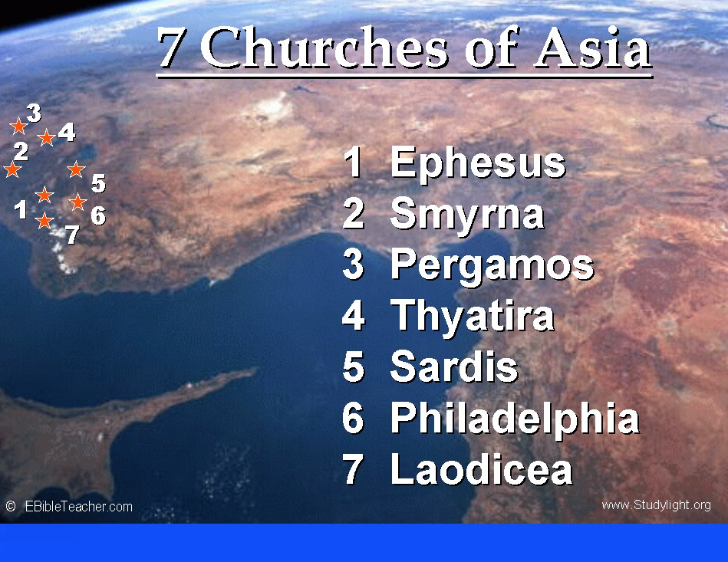

Slide 3
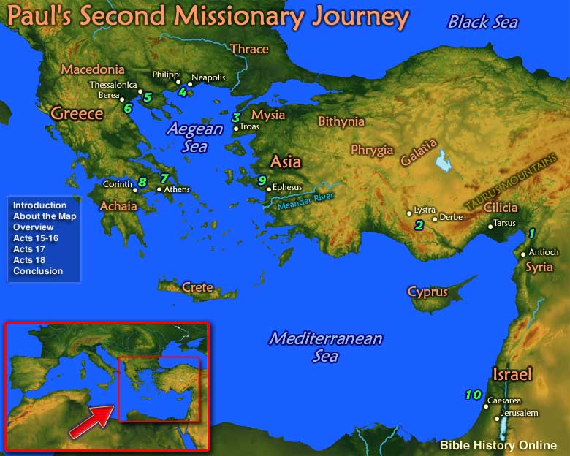

Slide 4
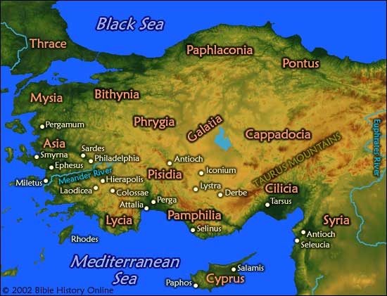
Asia Minor

Slide 5
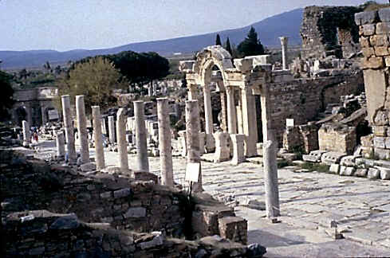
EPHESUS
Paul arrived briefly to Ephesus on his second missionary journey (Acts 18:18-21)
Colonized in the 11th century by the Athenians
Paul stayed for 2-3 years on third journey

Slide 6
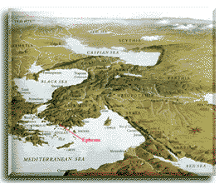
EPHESUS
Population:
200,000 – 500,000
Had Temple of Artemis (Diana) one of the seven wonders of the ancient world
Opposed to Paul’s preaching (Acts 19:24-31)

Slide 7

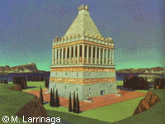
Painting © M. Larrinaga
I have lying, over me in Halicarnassus, a gigantic monument such as no other dead person has, adorned in the finest way with statues of horses and men carved most realistically from the best quality marble.
King Maussollos
in Lucian's "Dialogues of the Dead"

Slide 8

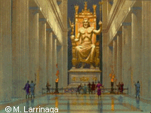
Painting © M. Larrinaga
In his right hand a figure of Victory made from ivory and gold. In his left hand, his scepter inlaid with all metals, and an eagle perched on the scepter. The sandals of the god are made of gold, as is his robe.
Pausanias the Greek (2nd century AD)

Slide 9

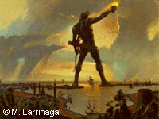
Painting © M. Larrinaga
To you, O Sun, the people of Dorian Rhodes set up this bronze statue reaching to Olympus when they had pacified the waves of war and crowned their city with the spoils taken from the enemy. Not only over the seas but also on land did they kindle the lovely torch of freedom.
Dedicatory inscription of the Colossus

Slide 10

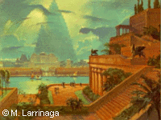
Painting © M. Larrinaga
The approach to the Garden sloped like a hillside and the several parts of the structure rose from one another tier on tier... On all this, the earth had been piled... and was thickly planted with trees of every kind that, by their great size and other charm, gave pleasure to the beholder... The water machines [raised] the water in great abundance from the river, although no one outside could see it.
Diodorus Siculus

Slide 11

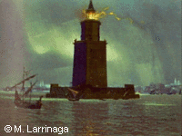
Painting © M. Larrinaga
Sostratus, the son of Dexiphanes, the Cnidian, dedicated this to the Saviour Gods, on behalf of those who sail the seas.
Dedicatory inscription of the Lighthouse

Slide 12

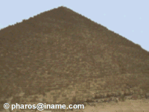
Man fears Time, yet Time fears the Pyramids
Arab proverb

Slide 13
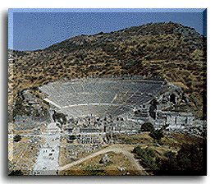
EPHESUS
One of the largest theaters in the world
“Then some of the officials of Asia, who were his friends, sent to him pleading that he would not venture in to the theater” Acts 19:31
“For I think that God has displayed us, the apostles, last, as men condemned to death; for we have been made a spectacle to the world, both to angels and to men” 1 Corinthians 4:9

Slide 14
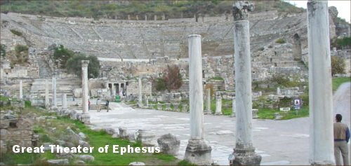

Slide 15
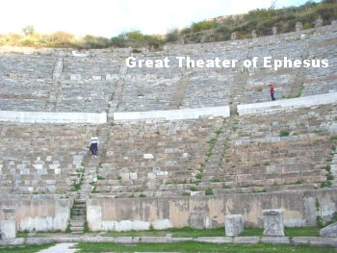

Slide 16
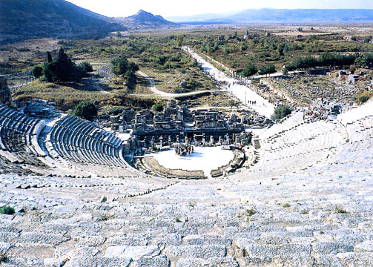
“Great Theater”

Slide 17
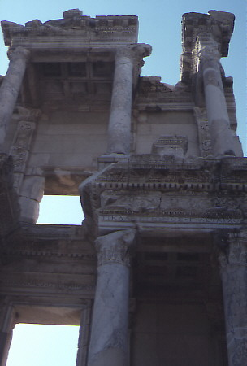
Façade of Library in Ephesus
Portraits Of
Wealth
~ 110 BC

Slide 18
EPHESUS
PRAISE (2:1-3)
PROTEST (2:4)
PRESCRIPTION (2:5, 6)
PROMISE/INVITATION (2:7)
Prescribed To:
REMEMBER & REPENT OR BE REMOVED!
Promise of:
Overcome and eat in Paradise
PRAISED FOR:
Works
Labor
Patience
Cannot Bear Evil Workers
Tested Others
Not Wearied
Protested for:
“LEFT YOUR FIRST LOVE”
“Forsake” (Matt. 19:27, KJV)

